Slide 1

AMBIENCE
Alma Scheffer
Carlos Mourão
José Bettencourt
Marina Taramelo
Notes:
Hello! Good afternoon to everyone present here. My name is Blabla and we are here to present our project Ambience to provide the best music selection or playlist that you need.

Slide 2
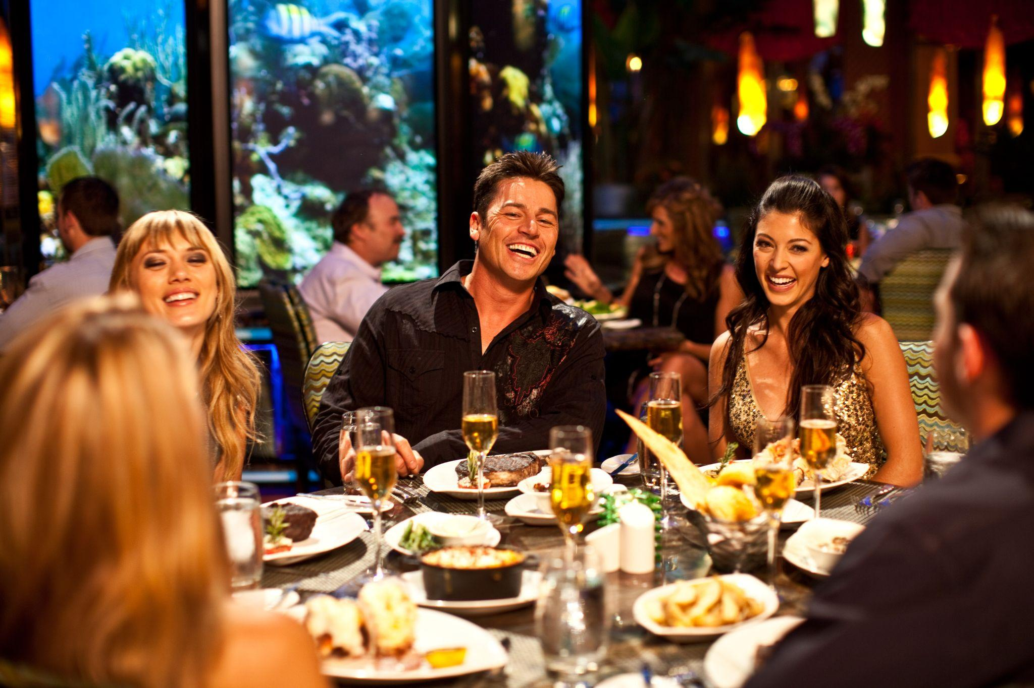
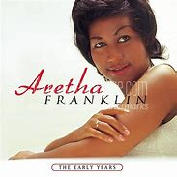
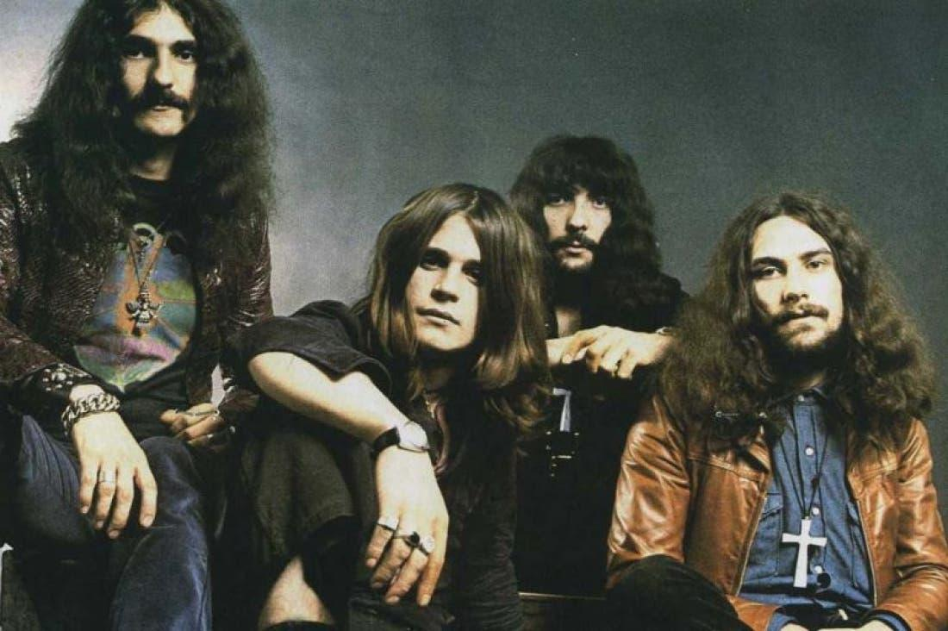

What type of music?
Black Sabbath
Paranoid
Heavy blues-rock
Notes:
Imagine that you are in a restaurant having a quiet diner with your family, which kind of music do you prefer to listen?
Maybe some of you would choose the second one, but maybe in a bar and of course with some beers.
for the atmosphere that I described is matching the first music, slower beat slows down your patroons and makes us feel comfortable and then we will eat slower and stay longer.
Normally, a higher volume level increases our heart rate, which leads to us doing other things faster as eating.
what it is important is match music to our brand identity to create the desired atmosphere.

Slide 3
Problem/Situation
Wrong music according to the venue
Bad reviews due to music
Might compromise profit
Notes:
Before I start, I would like you to imagine this scenario/situation: You are in your favorite restaurant or even trying a new restaurant that someone recommend to you and something isn’t right?! What do you think is the problem? I believe some of you thought about the food but NO, I am talking about all the scream conversations and loud noise because of the volume and type of music on the playlist.
So we can conclude there is a problem of wrong playlist to this venue (off course the venue can be a restaurant, pub or even a wedding, for example), maybe a situation of negatives reviews because of the music and not even the food that can compromise positive reviews and even profit. --- Next Slide----

Slide 4
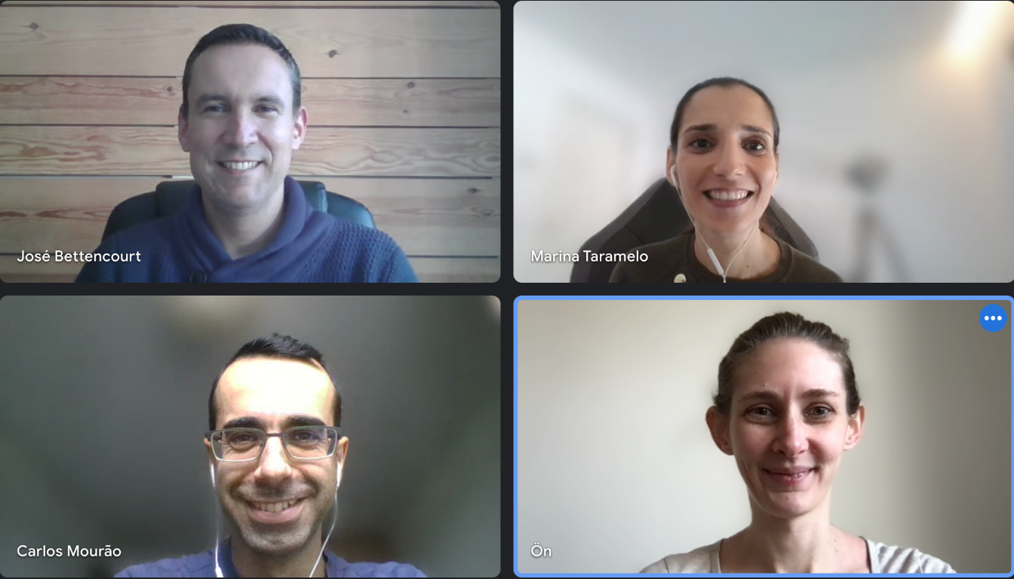
The Team
Notes:
And this is the amazing and beautiful team that worked in this project…
Our team fully understands the importance of choosing the right music.
This is why our designers work with customers to create the best matching playlists to drive the best results.

Slide 5
Thank you!
Notes:
And this is the amazing and beautiful team that worked in this project...

Slide 6
How to improve profit...
...with MUSIC?
Notes:
But now you all should be thinking how can the music help with the business? There is definitely a way and for that I will be passing to my colleague Blabla that will explain better this part. -------NEXT SLIDE-----

Slide 7
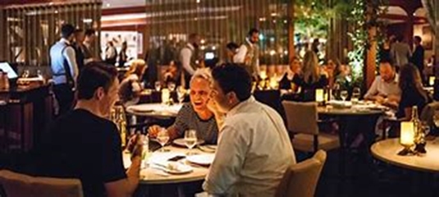
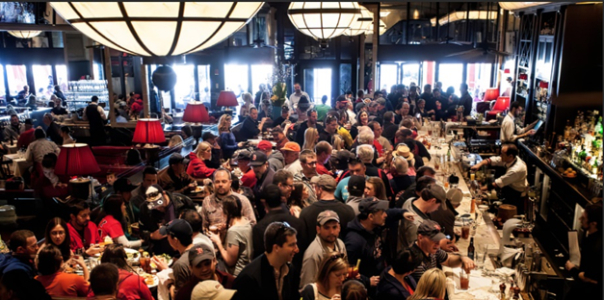

What are the business goals of a restaurant?
high rate of table turnover;
people staying longer to have another drink and keep talking;
Notes:
Match music to your brand identity to create the desired ambience.

Slide 8
Business goals of a restaurant? (TEST)
High Rate of Table Turnover
or
People Staying Longer
Notes:
Match music to your brand identity to create the desired ambience.

Slide 9

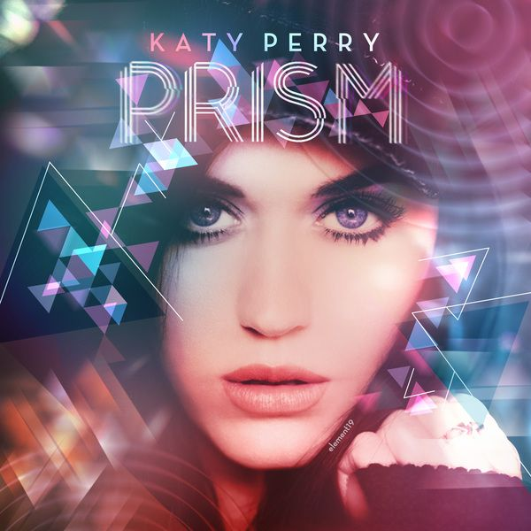
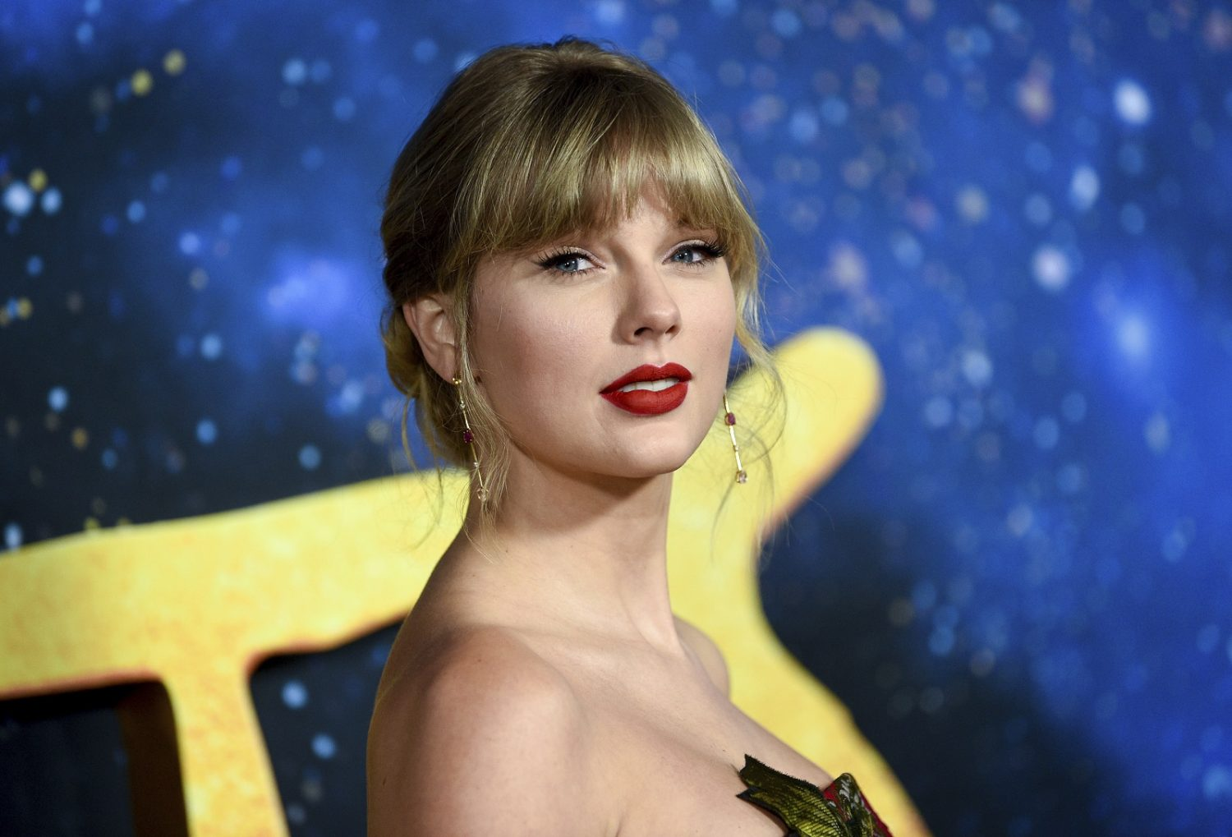



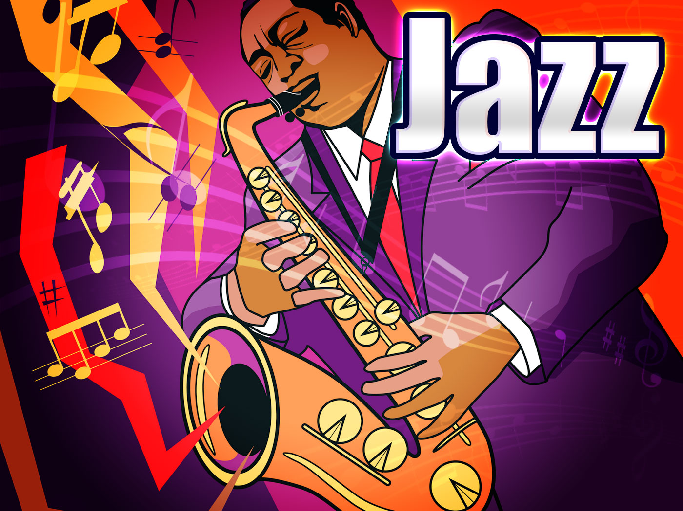
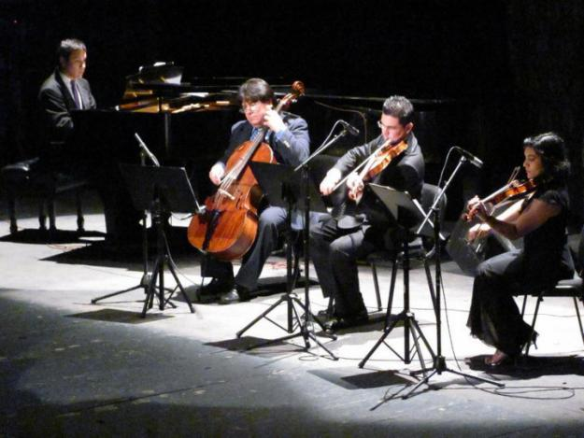
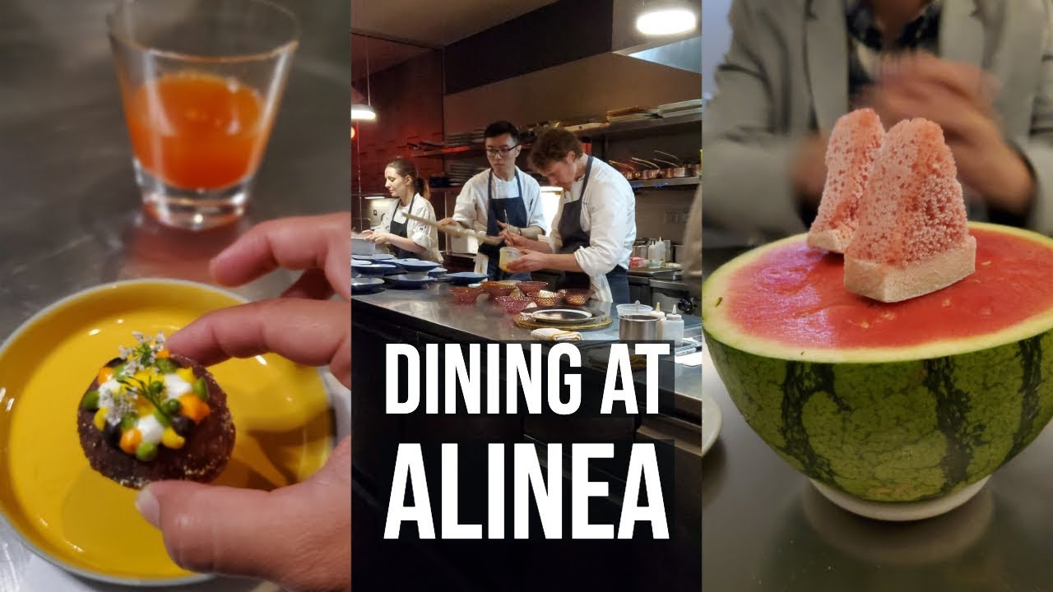
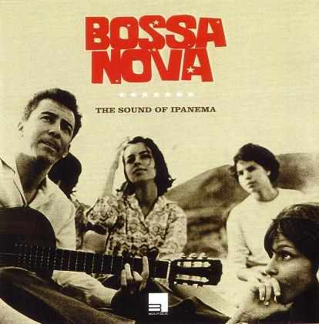
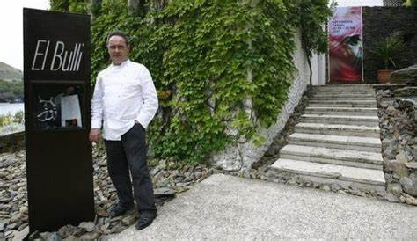
Can music define a restaurant?
High Rate of Table Turnover
People Staying Longer
Notes:
the faster the table turnover, the more customers you serve, (the higher the revenue), for this we have some examples as Mcdonalds, normally they play pop music, more energetic music, focused on speed, and many people who go to spots like this don't plan to eat their meals within the space. They order, they take the food away, and they eat it in a different location.
Fancy restaurants like Alinea and El Buli (are on the top list of the best restaurants in world) offer consumers the opportunity to step away from chaotic lives and explore a special meal, ,consumers may spend hours in a venue like this as they consume appetizers, main meal, and desserts, for a fine dining music playlist include jazz and classical music, as both music genres are associated with sophistication and class.

Slide 10
Future Improvements
Music by Year or Decade
“Music gives a soul to the universe, wings to the mind, flight to the imagination, and life to everything.” Plato

